Slide 1



Mass Transfer Rates of Ultracompact X-ray Binaries
Clyde Miller, Xander McLendon
Mentor: Pragati Pradhan
Department of Physics and Astronomy | College of Arts and Sciences

Slide 2

Acknowledgements
Embry-Riddle Aeronautical University Undergraduate Research Institute
Arizona Space Grant Consortium
Dr. Pragati Pradhan

Slide 3
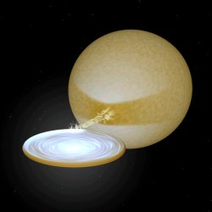
UCXB Background
Ultracompact X-ray binary (UCXB) systems are low-mass X-ray binary systems
Consist of a large donor star and a compact accretor object (i.e, neutron star, black hole)
Have short orbital periods
Image source: https://www.astro.ru.nl/~sluys/Binaries/ucxbs.html

Slide 4
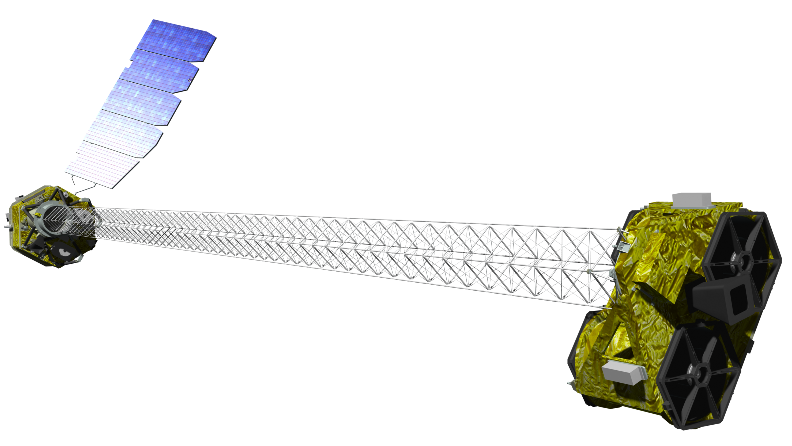
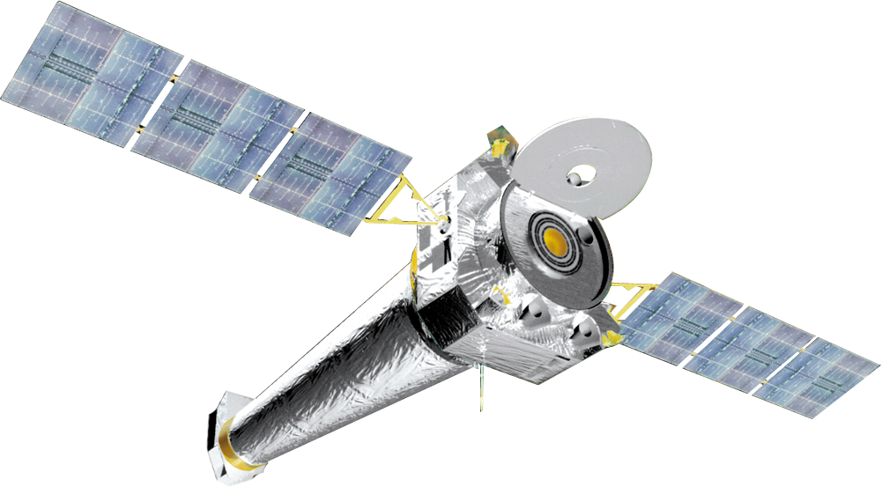
Source Background
4U-1916-053
Dips in absorption that align with orbital period (~50 minutes)
Observation with Chandra and NuSTAR
4U-0614
No dips in absorption
Observation with NuSTAR
1850-087
No dips in absorption
Observation with Chandra
@ NASA/JPL-Caltech

Slide 5
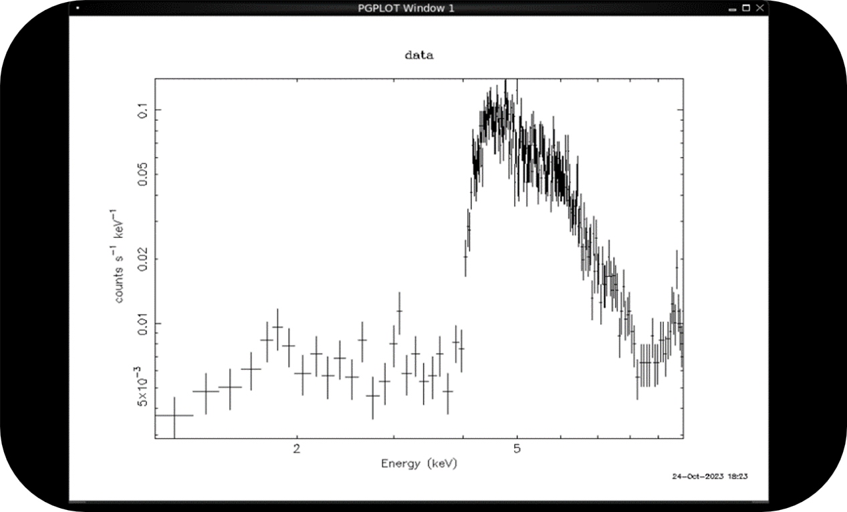
4U 1916-053 Findings with Chandra

Slide 6
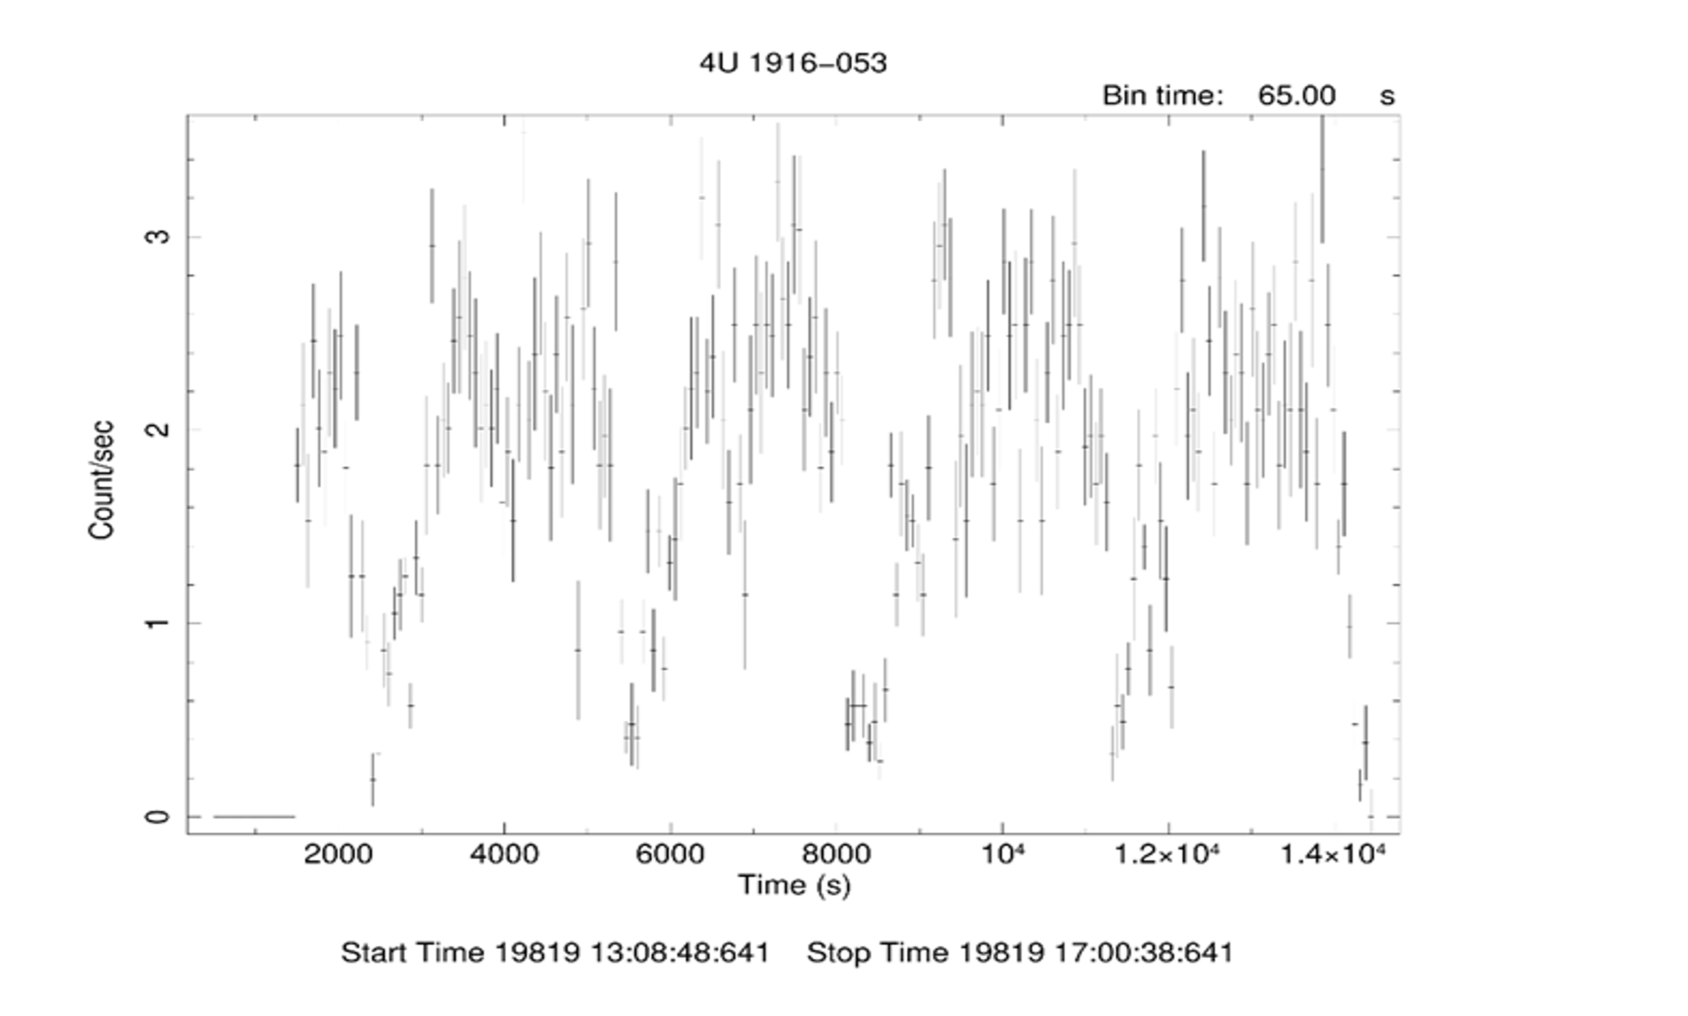
4U 1916-053 Findings with Chandra

Slide 7
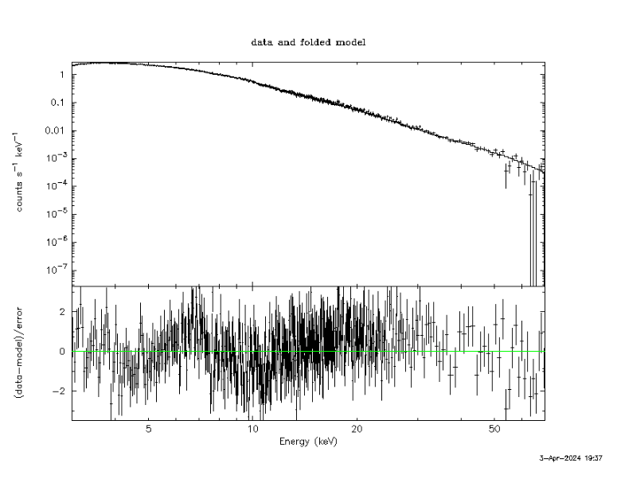
Model Fitting of 4U-0614 Shows Power Law and Blackbody Components

Slide 8
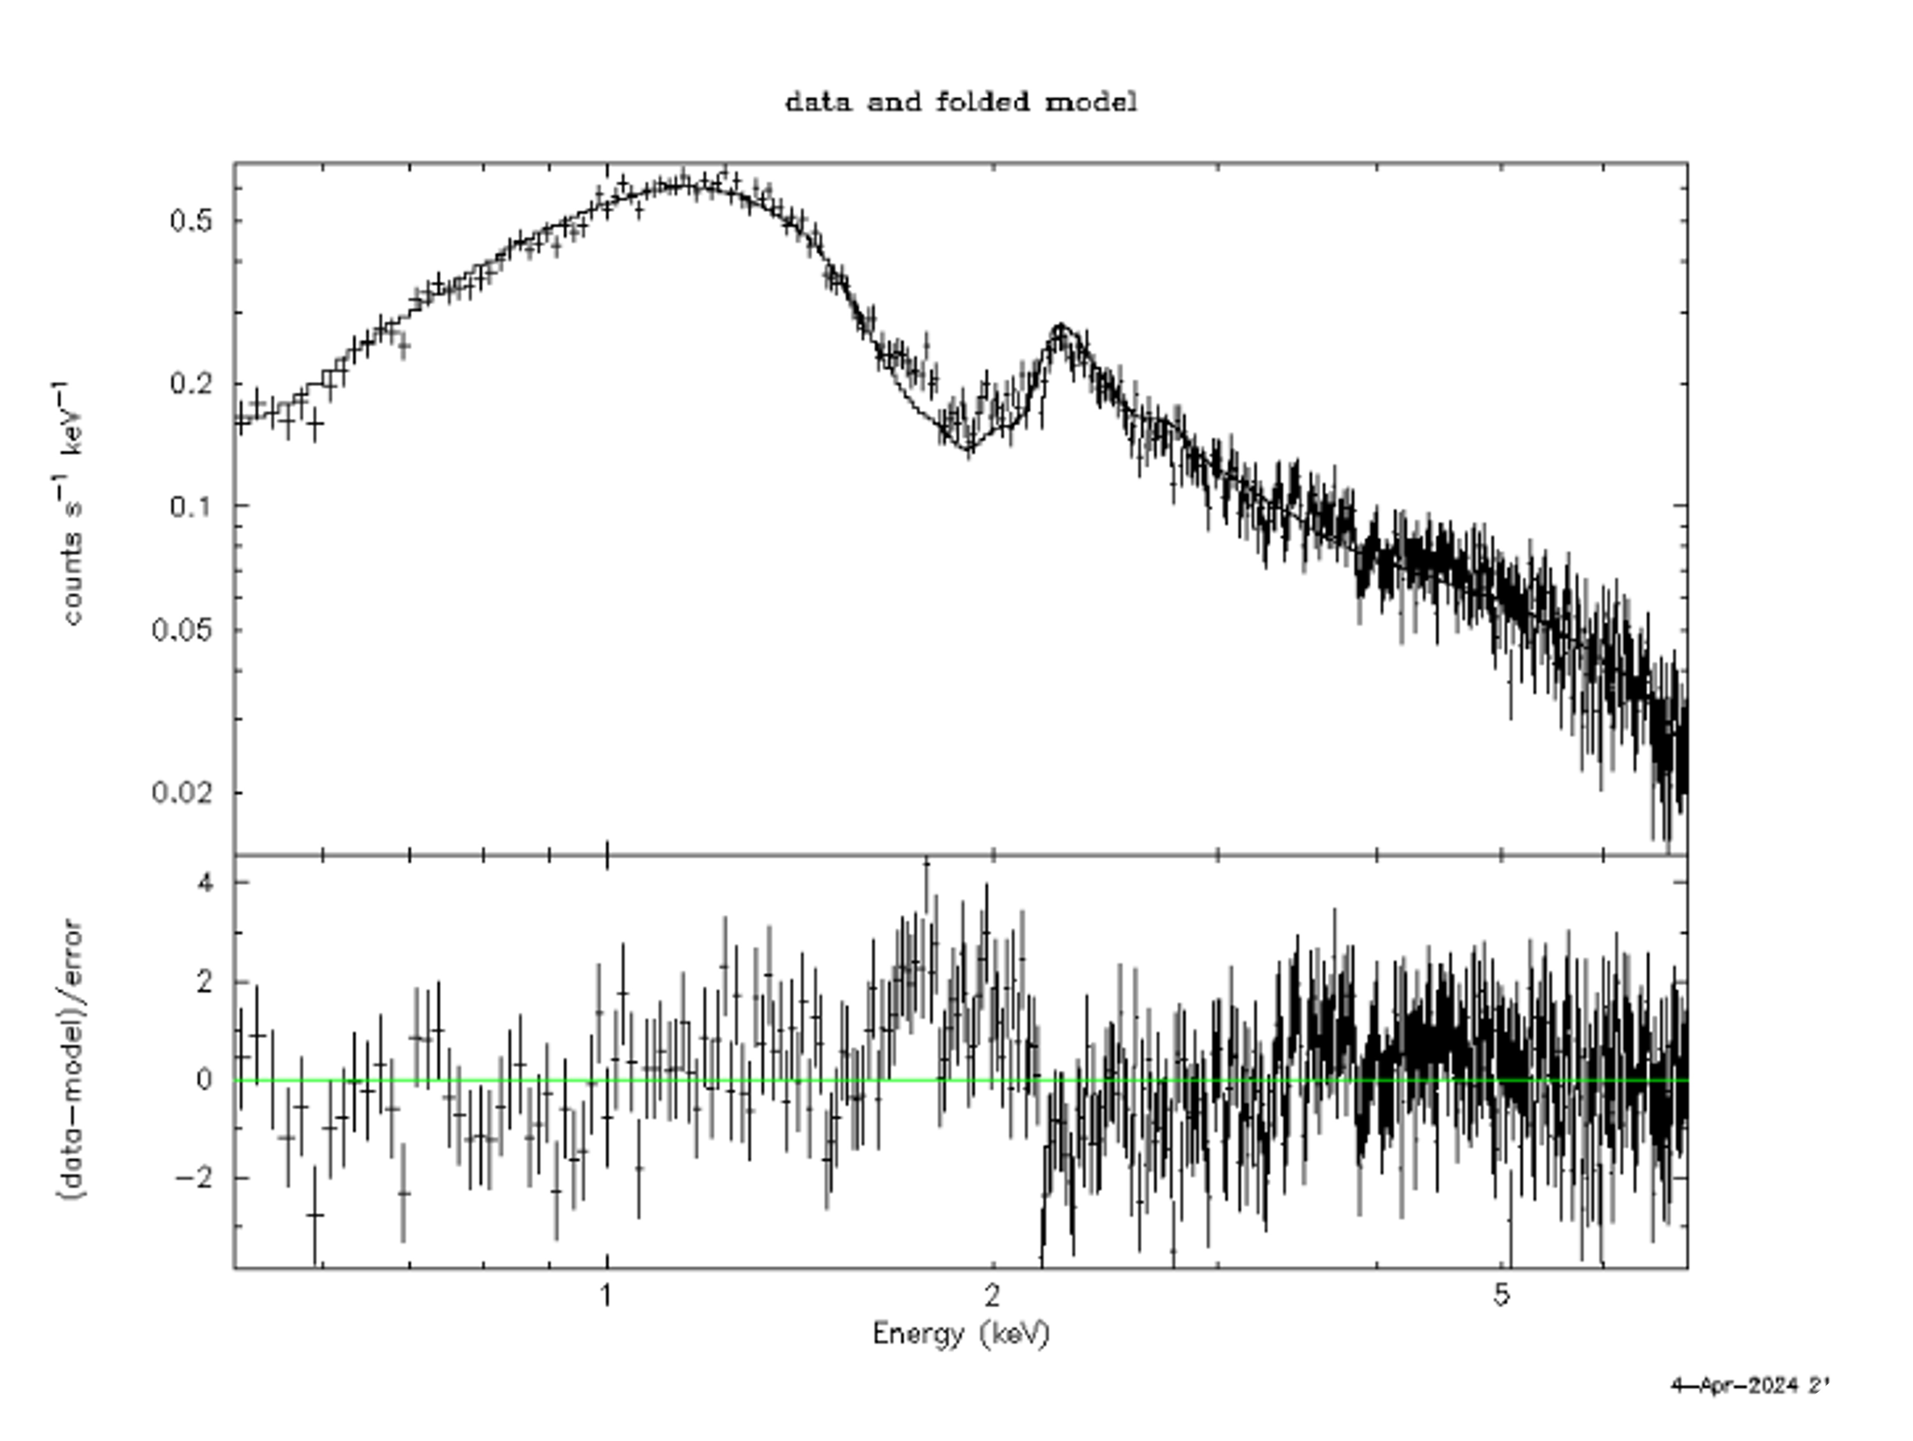
Model Fitting of 1850-087 Shows Power Law, Black Body, and Gaussian Components

Slide 9
Plans
4U 1916-053
Complete model fitting using NuSTAR
Determine flux and mass transfer
4U-0614
Determine flux and mass transfer
1850-087
Determine flux and mass transfer
Analyze mass transfer rates of additional UCXBs

Slide 10
Project Summary
Goal is to determine mass transfer rates from donor star to accretor object
4U 1916-053 will be compared to non-dipping sources
Variations between mass transfer and orbital period also being examined
Analysis on accuracy of current models for UCXB mass transfer

